Slide 1
Financial statement
UNIT-6

Slide 2
Finanace :-
Finance may be defined as that administrative area or set of administrative functions in an organization which relate with the arrangement of cash and credit so that organization may have the means to carry out its objectives as satisfactorily as possible.
In a modern money – using economy, finance may be defined as the provision of money at the time it is wanted.
Business finance can be broadly defined as the activity concerned with the planning raising controlling and administering of the funds used in the business.

Slide 3
Objectives of business finance
To provide continuously an adequate amount of capital to the business.
To give a reasonable rate of return to the investors.
To make optimum utilization of capital by using the principle of safety and profitability.
To have proper coordination of the activities of the finance department which those of the order departments of the company.

Slide 4
Kinds of capital
Fixed capital:-
Fixed capital is required for investment in fixed assets like plant, equipment, land, buildings etc.
The amount of fixed capital depends mainly upon following factors:-
Nature of Industry :
Whether it is heavy industry like steel , or is light industry lie textiles. Heavy industry need large amount of fixed capital, and light industries require smaller amounts of fixed capital .
Nature of production technique:
Whether production technique is manual, mechanized or automatised. Mechanized and automatised industries like steel and electronics require very large amount of fixed capital .

Slide 5
(b) Working capital :-
Working capital is required for day to- day working , and is meant for such purposes as purchase of raw materials, semi finished and finished inventories payment of wages, salaries, rent and advertisement etc
Working capital is invested thus in current assets which are converted into cash or money in short period.
Amount of working capital depend on following factors:

Slide 6
Regularity of industry :
Whether the industry is perennial like steel production or is seasonal lie sugar production. Perennial industries require lare amounts of working capital and seasonal industries require smaller amounts of working capital.
(ii) Period of production cycle:
Whether the production cycle is long as in case of ship- building or is short as in case of cotton textiles. Industries having long production- cycles require larger amounts of working capital and industries having short production- cycle requires smaller amount or working capital.

Slide 7
What is share?
Shares :-
“ Shares are the legal commercial documents which represent the equal parts of the total owned capital of the company.”
At the very beginning of formation or registration of a company , the government fixed the amount of the share capital or the amount which the company is authorized to raise in market through the sale of shares.

Slide 8
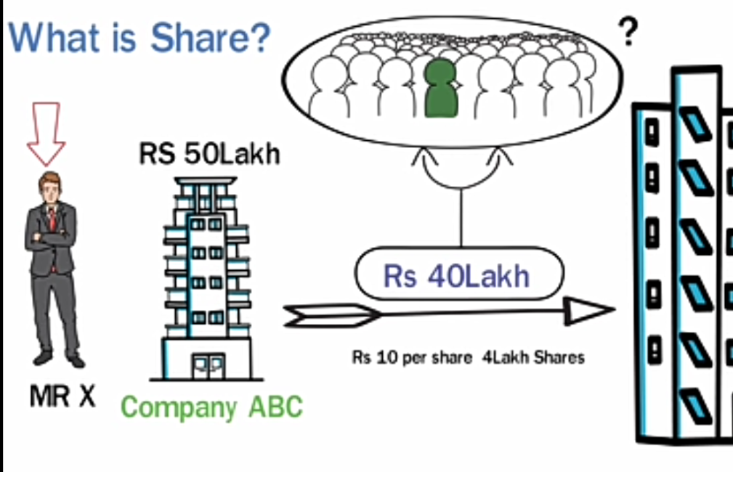

Slide 9
Types of shares
Shares are of the following two kinds:
Ordinary shares
preference shares
Ordinary shares or Equity shares :
Ordinary shares are those shares whose owners take the maximum risk in business .
The ordinary shareholder is the real owner , and hence the maximum risk- taker. He sinks, swims and floats with the fluctuating fortunes of the company.

Slide 10
Equity capital determines the entire financial structure . If the proportion of equity – capital to the total capital of the company is large , it shows its great strength. In the apposite case, it shows its weakness.
Dividend is available to an ordinary shareholder only after payments made to all debenture – holders and preference share holders. If after paying to them, nothing is left, he will get nothing. But if much is left, he will get much.

Slide 11
Preference shares
“ Preference shares get preference over ordinary shares in respects both of (i) rate of dividend, and (ii) Time of payment of dividend. “
Preference share holders usually get a fixed rate of dividend, and are paid before the ordinary shareholders are paid.
But preference shareholders will receive their guaranteed or fixed dividend.

Slide 12
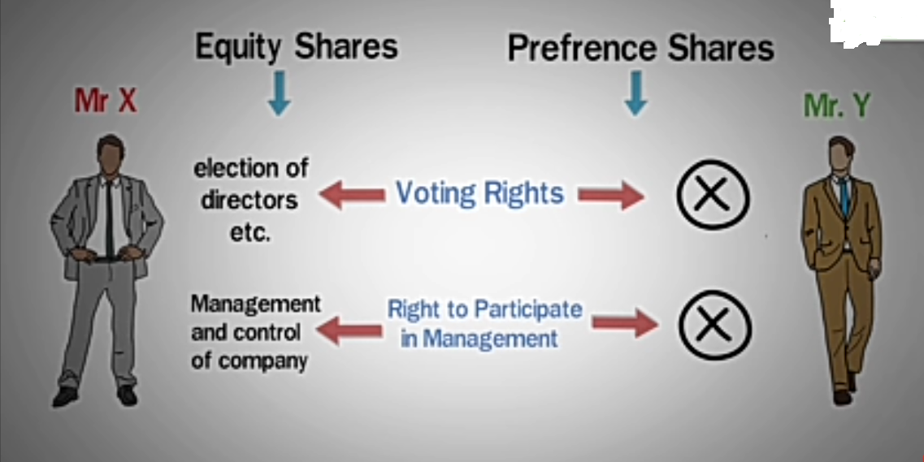
Difference between preference share and Equity shares

Slide 13
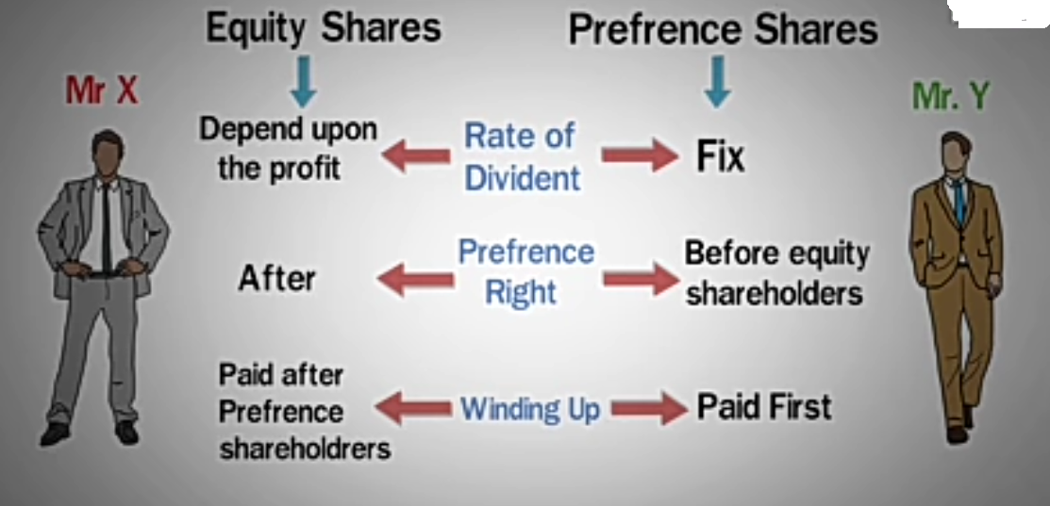

Slide 14
What is share market.
Share market is a place where buying and selling of shares is done.
Types of share market (popular)
BSE ( Bombay stock exchange)- 1700 companies
NIFTY (delhi)
NSE ( National stock Exchange)- 54000 Companies
Sensex ( Mumbai)

Slide 15
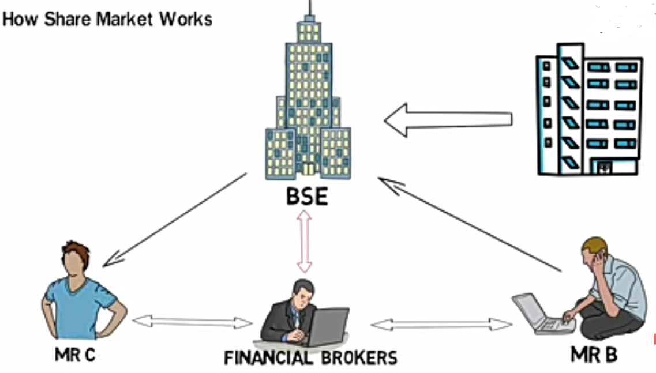
How share market works

Slide 16
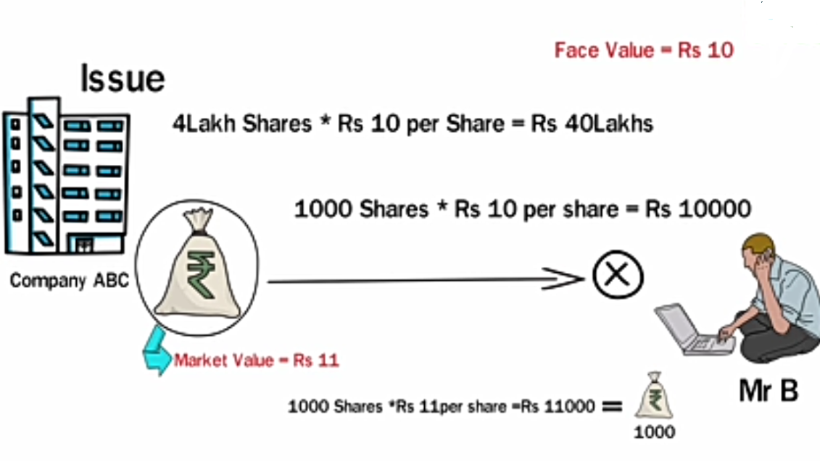
How a person can earn or loose money through shares.

Slide 17
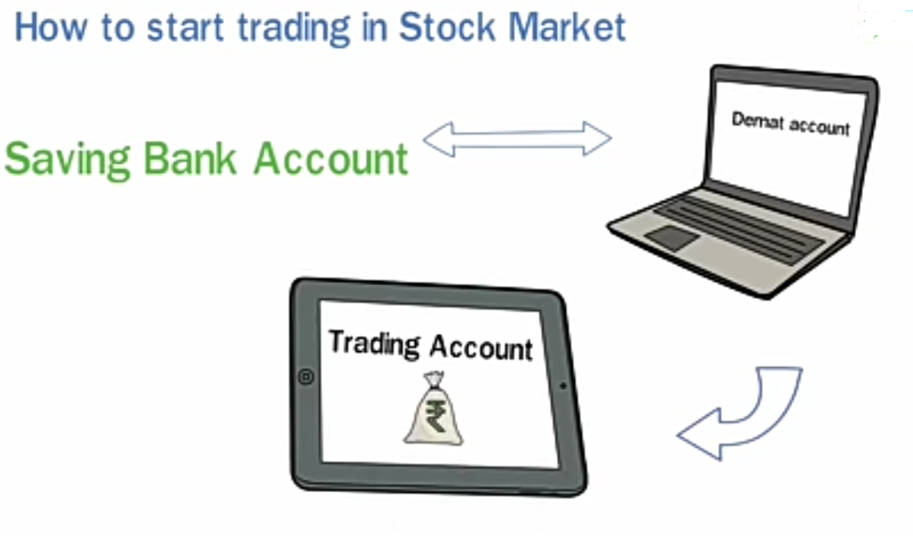
How to start trading in stock market

